Slide 1
Consumers & products
Marija Banovic
Associate Professor
maba@mgmt.au.dk
MAPP Centre, Department of Management, Aarhus University, Denmark

Slide 2
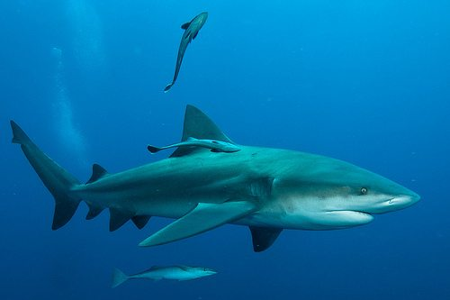
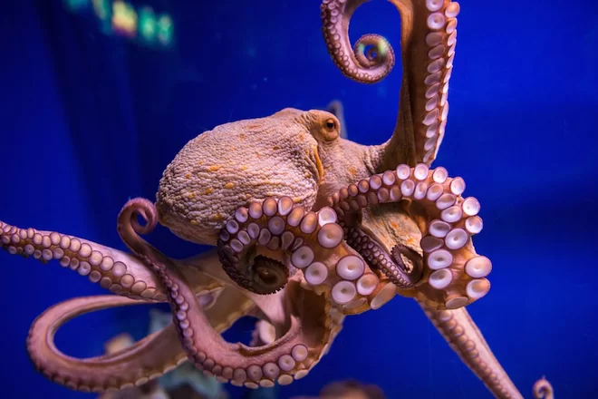
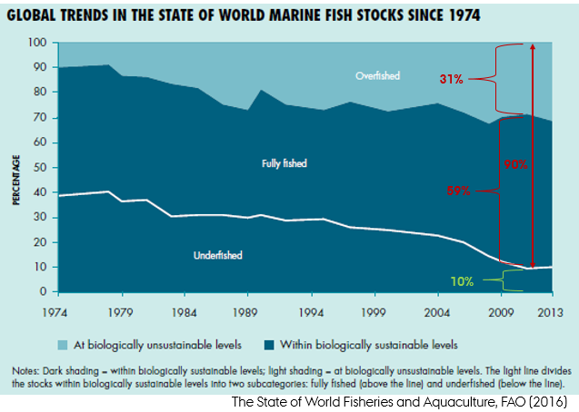
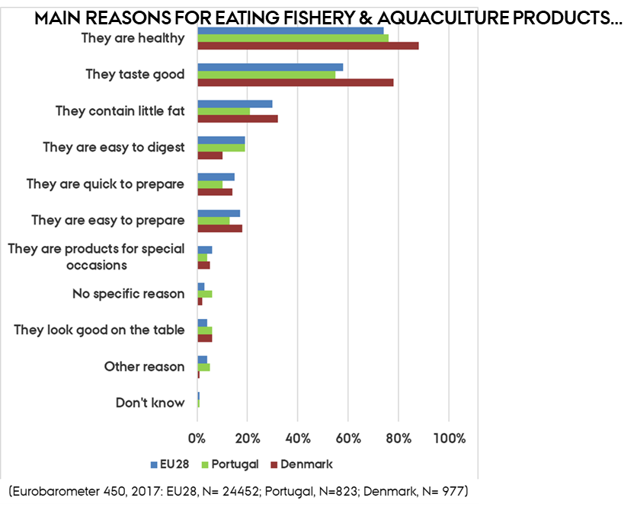
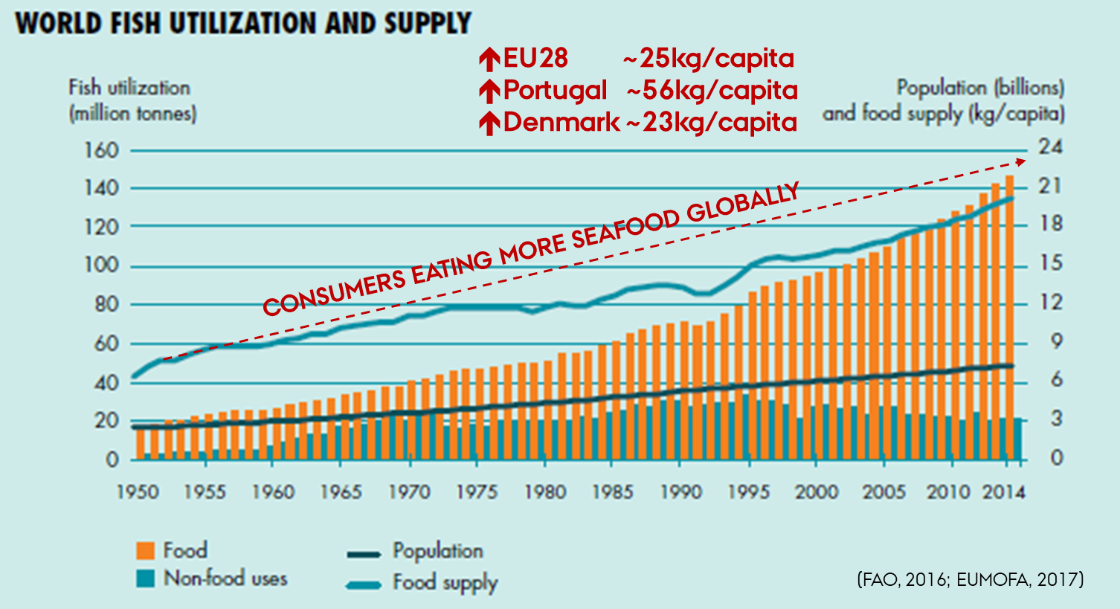
‘So long and thanks for all the fish’

Slide 3
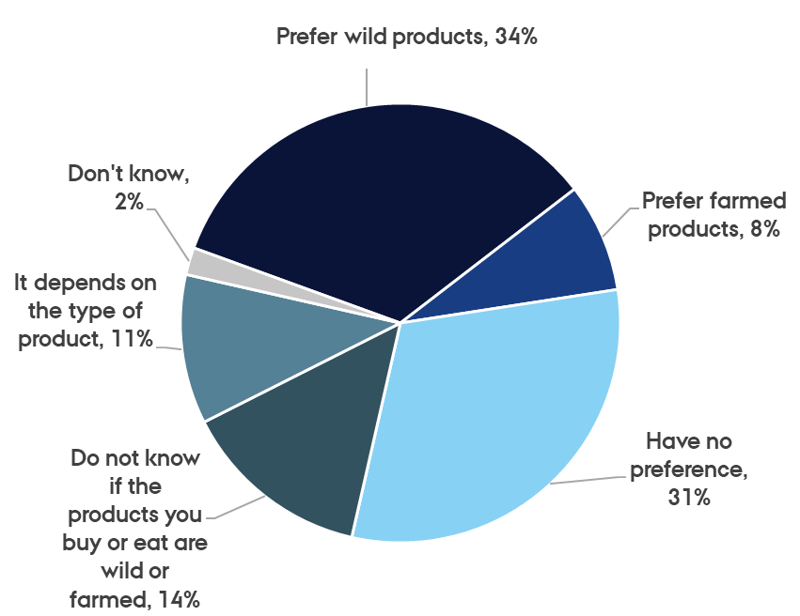
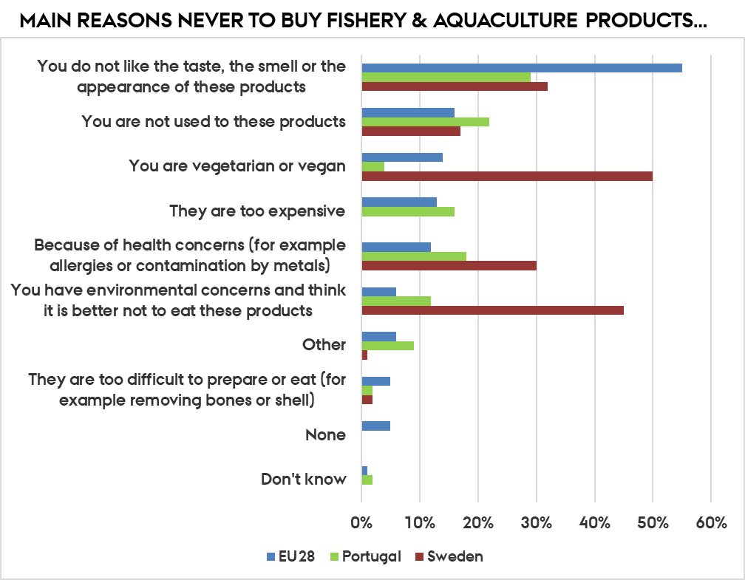
aquaculture products visible?
(IN)VISIBLE?
(Special Eurobarometer 450: EU28, N= 24452; year 2017)

Slide 4
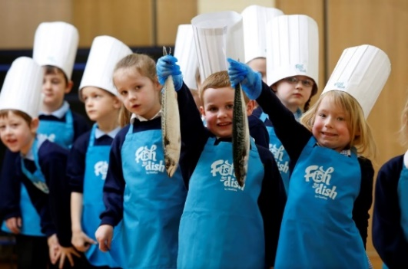
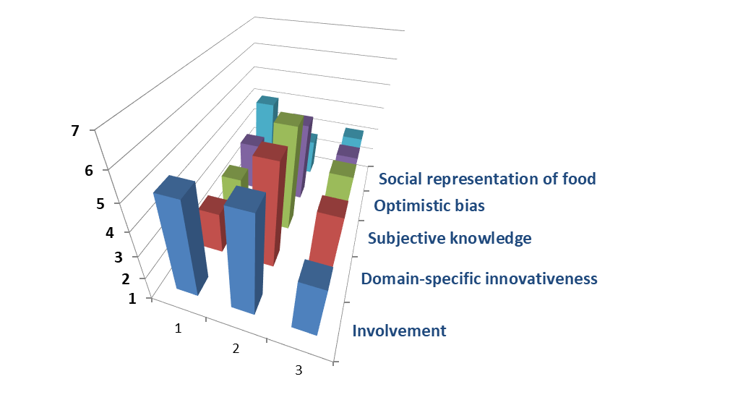
Consumers, WHO?
Ambiguous indifferent
(34%)
Early adopters
Involved innovators
(36%)
Involved traditional
(30%)
(Reinders et al., 2016)
(Banovic et al., 2019)

Slide 5
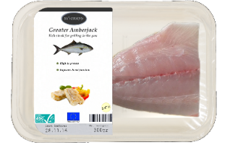
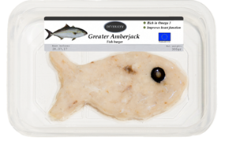
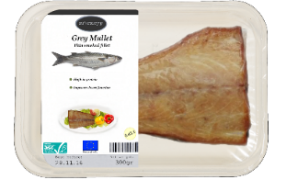
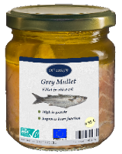
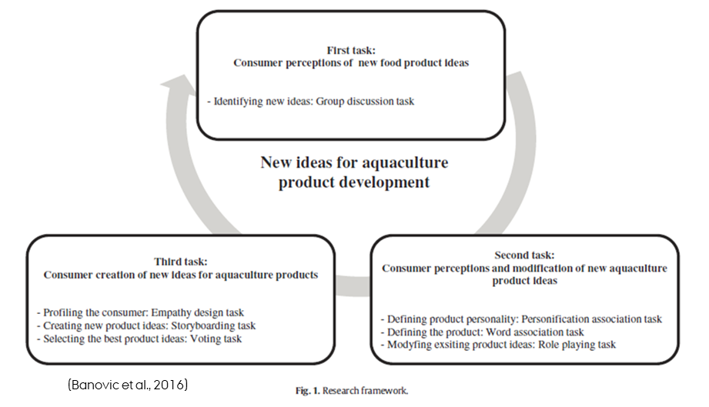
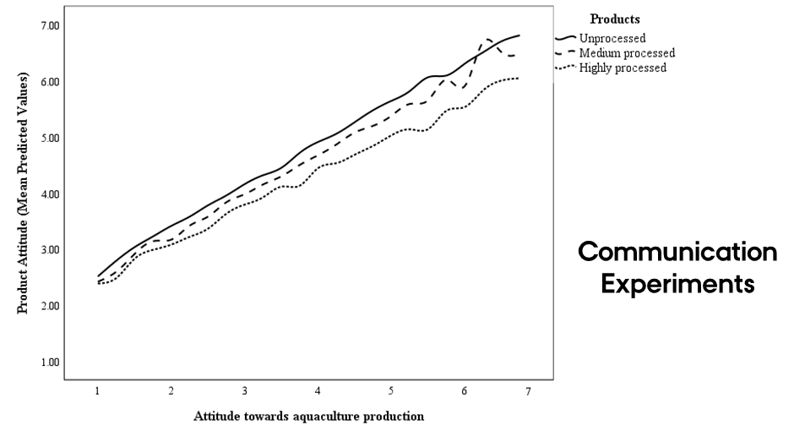
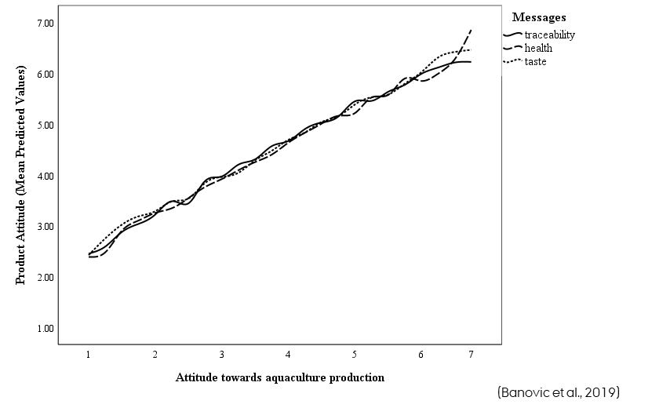
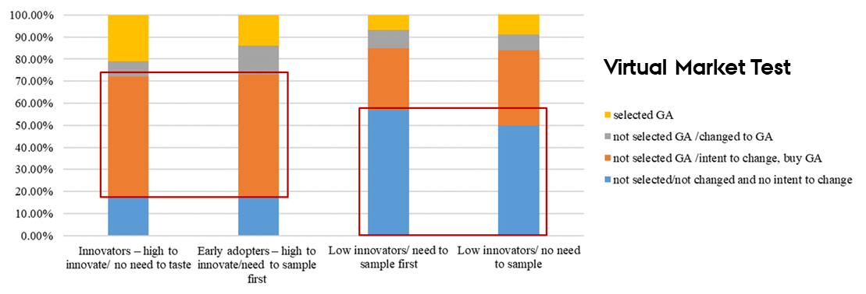
Products, What?

Slide 6
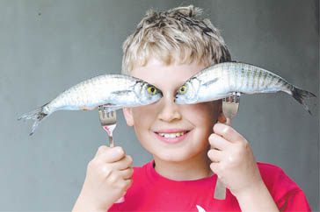
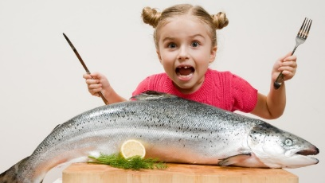
What did we learn from diversify?
Need to feel familiar (‘Fish from Portugal’)
Adapt information to the type of aquaculture
Highlight the most valuable benefits and attributes (i.e. Country of Origin)
Need to feel true (EU aquaculture overshadowed by legitimate doubts)
Better link between production method, environmental concerns, responsible consumption and aquaculture (i.e. traceability, ASC logo)
Aquaculture products that… STAND OUT IN A CROWD…
Need to feel effortless (‘All the pleasure with little effort’)
Less clutter - convenience at purchase point & at home - storytelling, recipes
Need to feel good (‘Super-healthy fresh fish fillet for a healthier-happier day.’)
Associations to healthy & tasty diet - invoking positive emotional states
Need to provide if…then plan (‘Where’, ‘When’ & ‘How’)
Facilitate product implementation – communicate what consumer should do (e.g. ‘Eating this product is an easy way to protect and improve your cardiovascular health.’)
Need to offer new fish products - innovate (‘From fish skin to a handbag’)
Decrease the fish waste appeal to consumer…biofuel, handbags…

Slide 7
This work has received funding from the European Union’s Seventh Framework Programme for research, technological development and demonstration – DIVERSIFY (KBBE-2013-07 single stage, GA 603121)
http://www.diversifyfish.eu/
THANK YOU
FOR
YOUR ATTENTION!
Marija Banovic
e-mail: maba@mgmt.au.dk

