Slide 1
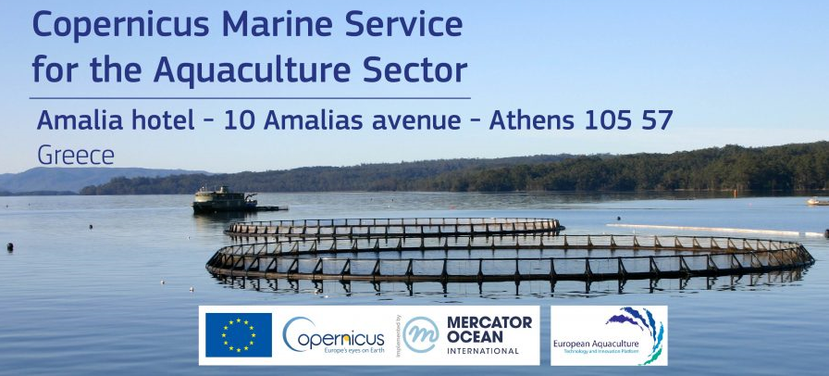
Expectations and strategic objectives of the aquaculture stakeholders concerning MARINE DATA
Speaker:
Yannis Pelekannakis
Aquaculture Advisory Council
Notes:
1

Slide 2
THE AAC IS AN AQUACULTURE DIALOGUE GROUP
ADVISORY COUNCILS = BODIES OF EU INTEREST
Stakeholder led – non profit organization
Advice to European Commission and Member States
Any new legislative, regulatory or legal measure at European or national level that affects aquaculture
A EUROPE-WIDE ADVISORY COUNCIL
60% - Industry (producers, feed, veterinarians, …)
40% - other interest group (NGOs, Scientists, …)

Slide 3
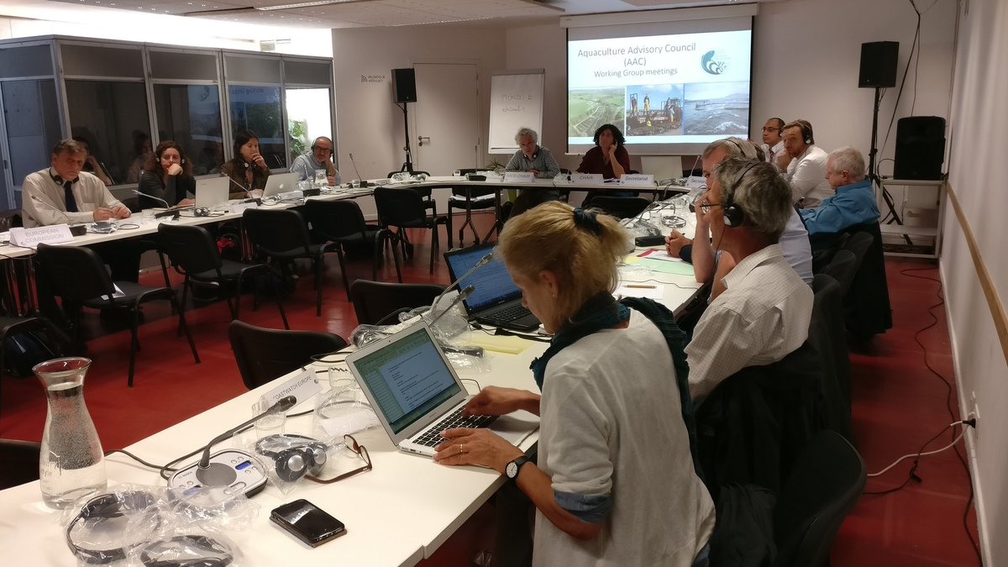
AAC Structure
Executive Committee
20 members
General Assembly
60 members
WG1
Finfish
WG2
Shellfish
WG3 Horizontal Issues

Slide 4
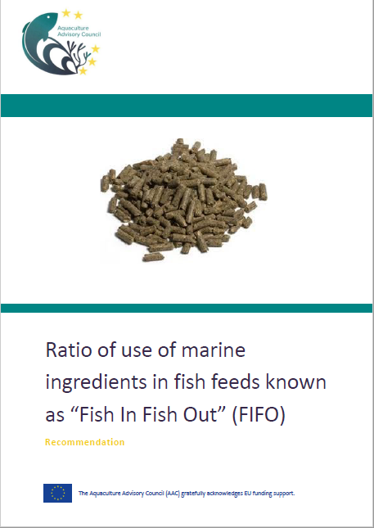
RECENT ADVICE / POSITION PAPERS
The Fish in Fish out ratio
Eligibility of fish vaccines for EU funds
Level playing field
Subsidized Turkish aquaculture imports into the EU
Fish welfare at slaughter
Available on our website: www.aac-europe.org
Credits: Leo Kirchmaier

Slide 5
AAC work on data collection
No official AAC position on this topic yet.
Ongoing selection process for a consultant
to start working in October 2019.

Slide 6
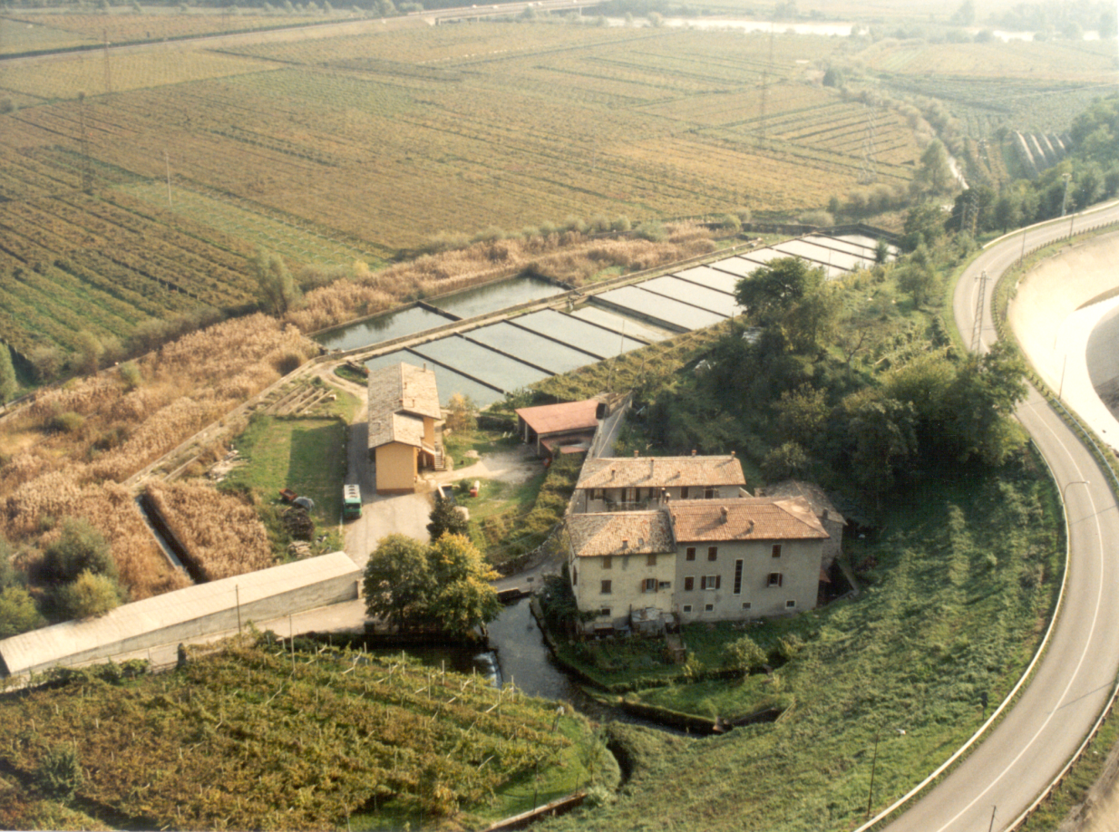
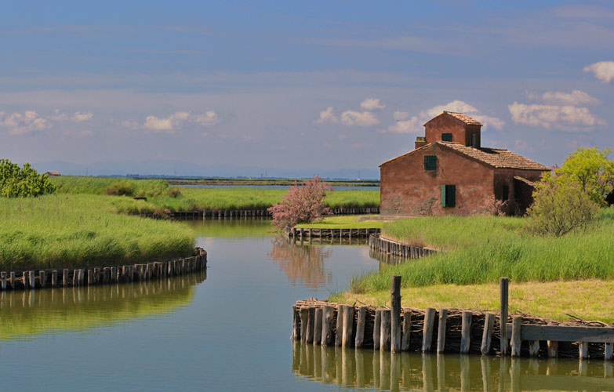
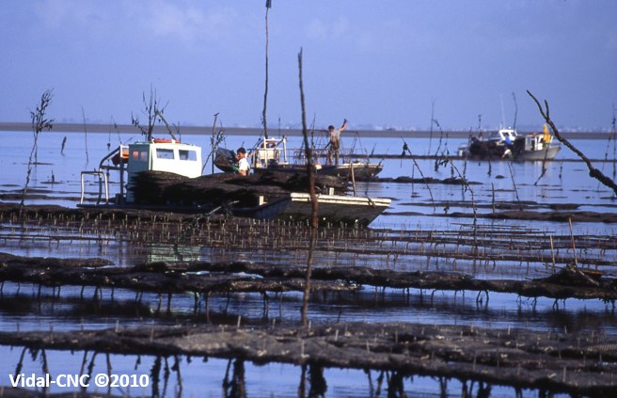

Slide 7
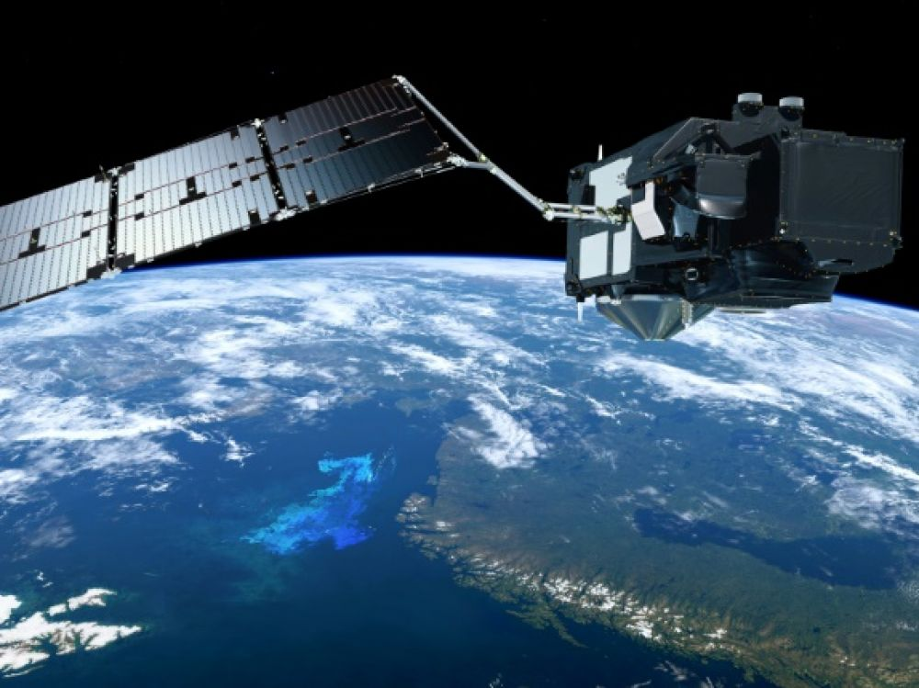
Expectations and strategic objectives of the aquaculture stakeholders
Satellite and real time data monitoring and assessment
Move from retro-active measurement towards real-time monitoring and more regular site assessment
Integration of automated surface/aquatic measurement (sensors) with satellite measurement
Data that can support/simplify environmental monitoring and impact assessments
Credits: Leo Kirchmaier

Slide 8
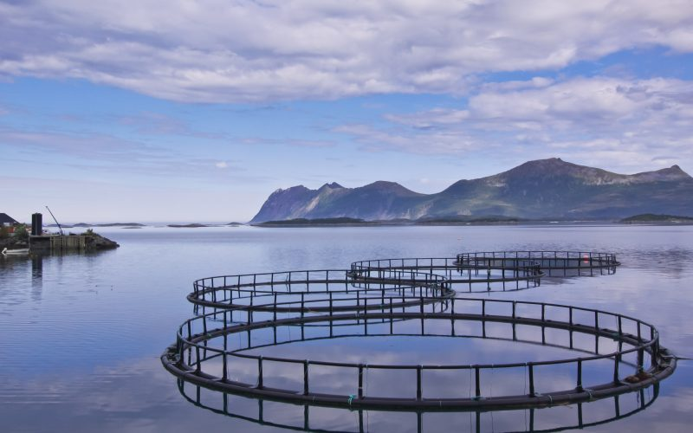
Expectations and strategic objectives of the aquaculture stakeholders
II. Predictive and analytical tools
Convert ‘big data’ into trends and predictive analytical tools to:
Assess the marine environmental status at regional/local level
Develop predictive - early warning models e.g.:
Phytoplankton evolution forecast
Effects of climate change on aquaculture (e.g. ClimeFish & CERES)
Assist the site selection/management for aquaculture operators

Slide 9
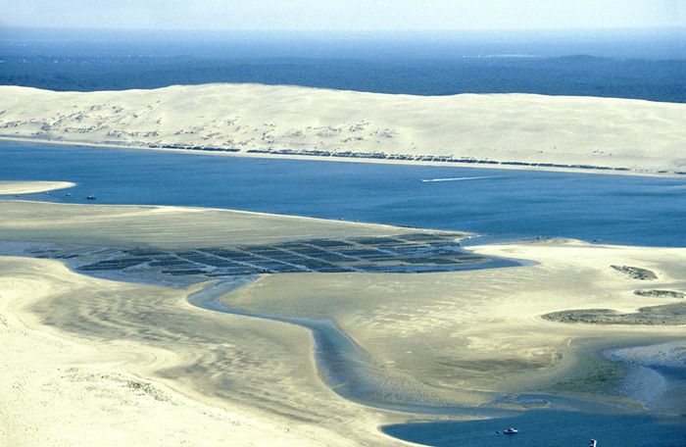
Expectations and strategic objectives of the aquaculture stakeholders
II. Predictive and analytical tools
Convert ‘big data’ into trends and predictive analytical tools to:
Support the licensing procedure (environmental impact assessment for new farms, relocation, expansion)
Evaluate stocks where possible (e.g. shellfish sector)
Assist the design of environmental policies
Credits: Vidal Banc D’Arguin 2010

Slide 10
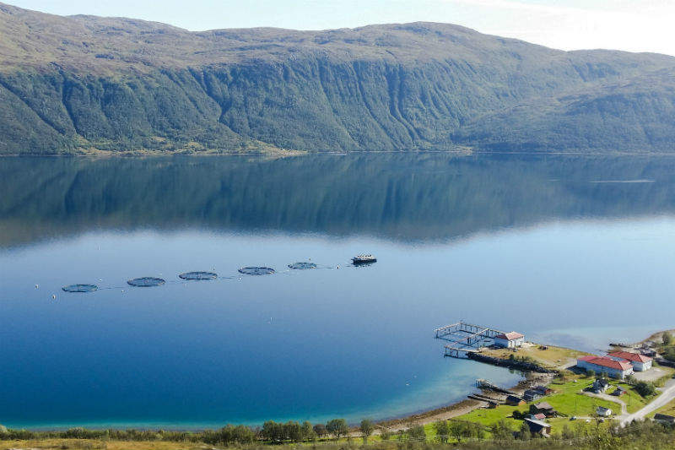
Expectations and strategic objectives of the aquaculture stakeholders
III. Assess the impact of aquaculture on the marine environment
Monitoring of ecological impacts – including surveying species population and possible changes in habitats
Data on disturbance & displacement effects of aquaculture farms on protected species
Data on nutrient input into ecosystems
Data on plastic input into ecosystems

Slide 11
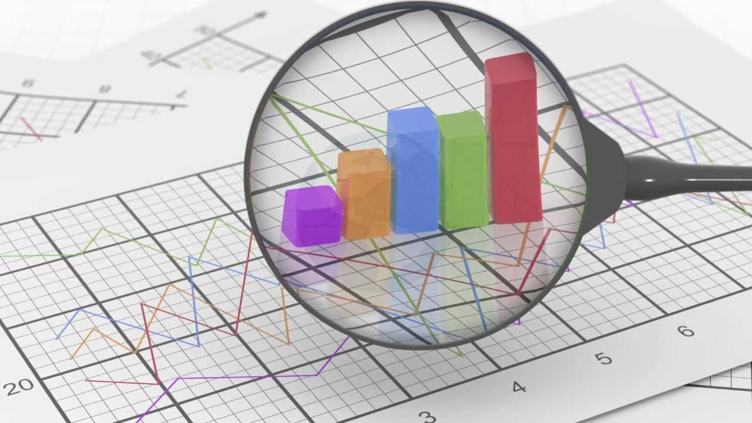
Expectations and strategic objectives of the aquaculture stakeholders
IV. Accessible and public data
Open access for all stakeholders
Available in several languages

Slide 12
Expectations and strategic objectives of the aquaculture stakeholders
INVITATION to discuss in the framework of the AAC:
Can you measure and provide those data?
Best instruments to be developed according to stakeholders needs?

Slide 13
Thank you!
For any inquiries:
AAC Secretariat
Cécile Fouquet – AliénorEU
11 Rue de l’Industrie, Brussels 1000
cecile.fouquet@aac-europe.org
Website www.aac-europe.org
Twitter @aac_Europe
The Aquaculture Advisory Council (AAC) gratefully acknowledges EU funding support.

